Slide 1




Clean Industrial Policy: Standing on the Shoulders of Giant Gnomes?
Ralf Martin
Imperial College London and Centre for Economic Performance, LSE
Based on joint work with Dennis Verhoeven, Charlotte Guillard (UCL), Dennis Verhoeven (Leuven&CEP), Pierre Mohnen (Maastricht), Catherine Thomas (LSE)

Slide 2


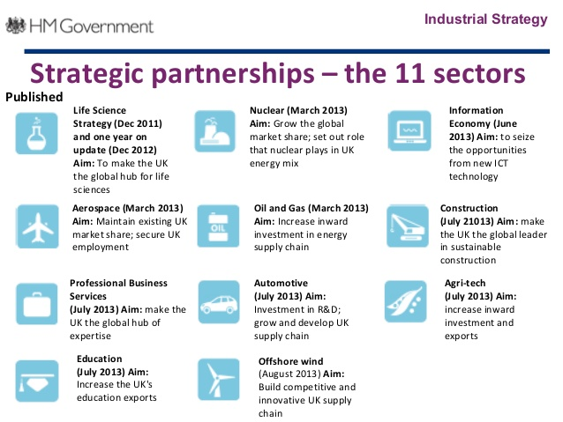

Background
Renewed interest in Industrial Policy
Vertical Targeting

Slide 3
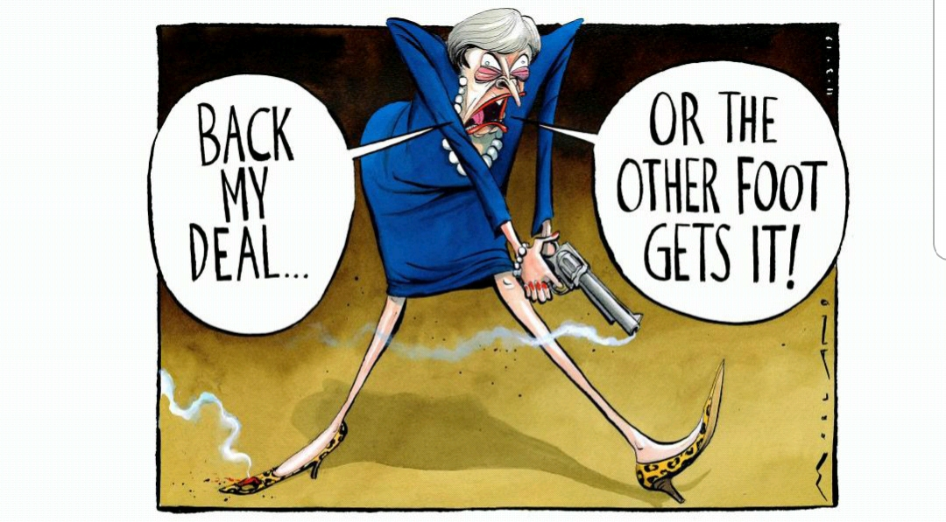

But how to target?
Focus on areas of comparative advantage?
Mission Orientation (Mazzucato)?
Climate Change?
Health?
Defence?
Often the mission is economic growth
Even more often the mission is growth+

Slide 4
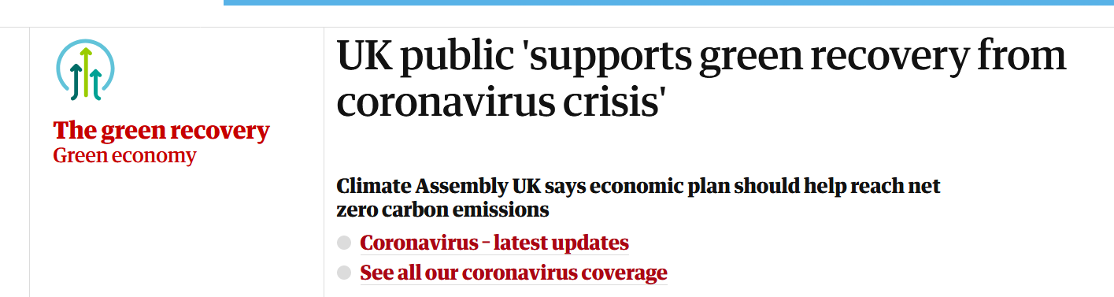
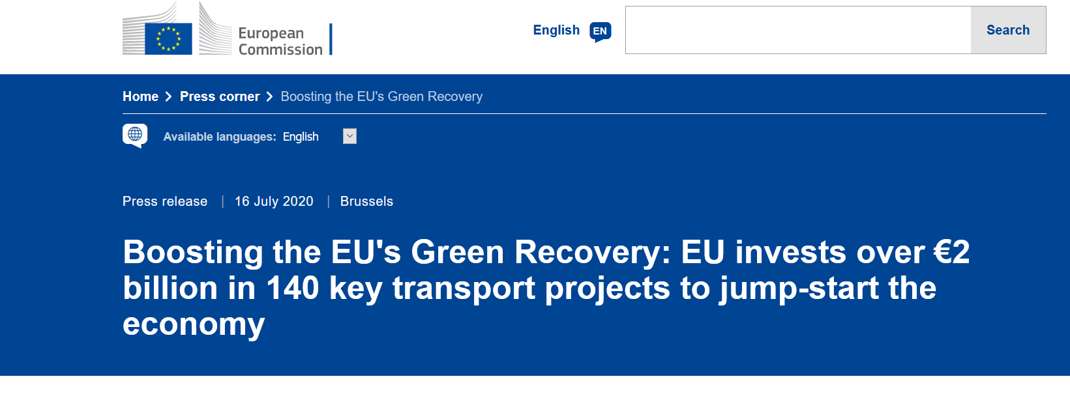
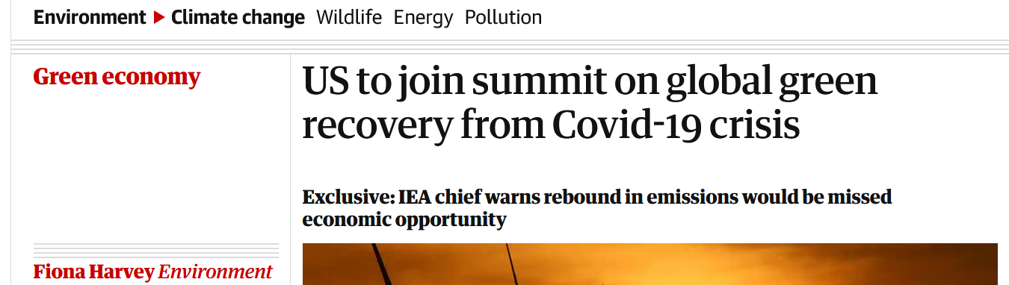
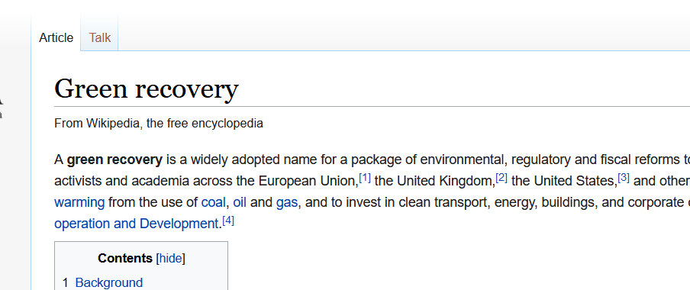
The ultimate Growth+ Example
Everybody wants a green recovery…..

Slide 5

Premise of our research
For state intervention to lead to growth we need a clearly identified market failures as a necessary condition
Knowledge spillovers obvious case
For vertical intervention we need to identify technology areas or sectors that generate more spillovers than others
We need metrics that can do so ex-ante and comprehensively

Slide 6

Feasibility of green recovery
For a green recovery we need to invest in clean technologies that generate the highest knowledge spillovers
(higher than other/dirty tech)
>

Slide 7

How well are clean spillovers internalized at levels relevant for policy?
Even if spillovers are strong no(country)body might have an incentive to act on them?

Slide 8
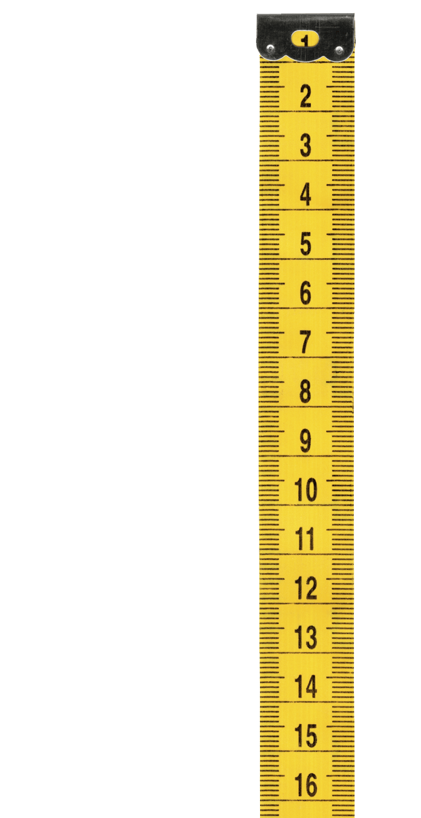

How to measure spillovers?
→ Patent data
Limitations
Not all Innovation is patented
Heterogeneity even within patented innovation
More relevant for some techs vs others
New methodology
Particularly when comparing across technologies

Slide 9
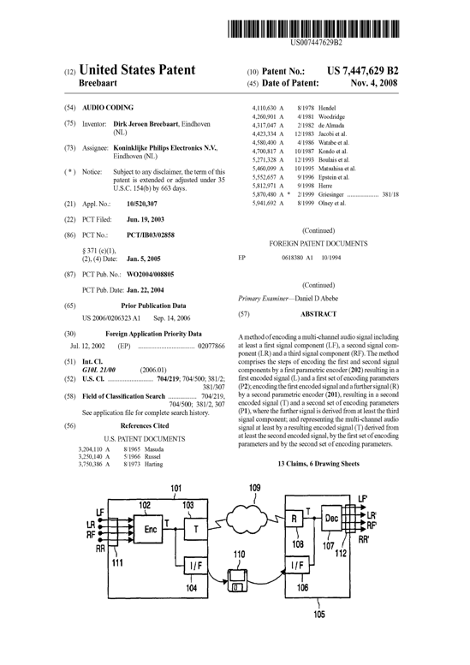
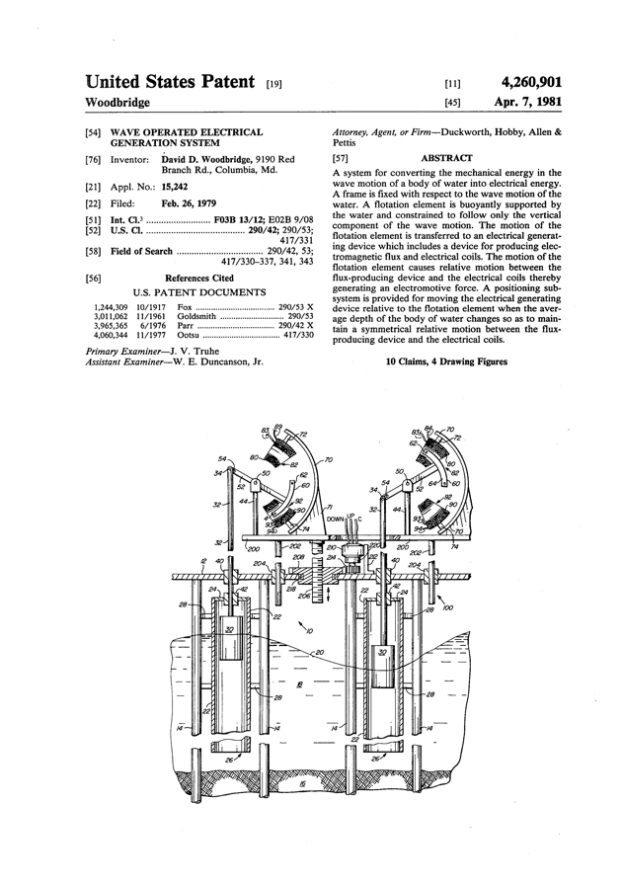
Knowledge Spillover Example
Understanding Ocean waves helped in dealing with Audio Waves
Notes:
Here is another example: A patent on audio encoding from 2008 cites a patent for a wave power generation system from 1981; i.e. understanding ocean waves somehow helped to develop new ideas in the handling of audio waves.

Slide 10
P-Rank
Patent Rank: A better way to measure the social value of innovations
Based on Google’s Page Rank
Direct and Indirect Spillovers
Takes account of variation in the private value of innovation
Allows to differentiate between “national” and “global” spillovers
Industrial Strategy Index: A better way to measure the marginal impact of public subsidies on the social value of innovations
ISTRAX
Account for R&D cost differences between sectors
Account for differences in availability of marginal ideas between different sectors
Accounting for variations in “additionality” of public support

Slide 11


Giant Gnomes and Illusory Giants
Giant Gnome
A
B
Illusory Giant

Slide 12
Differences in the value of Innovations
A
B
Private Value (PV)=$1MM
PV=$100MM
PV=$0.1MM
PV=$0.1MM
PV=$0.1MM

Slide 13


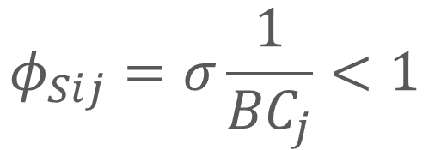
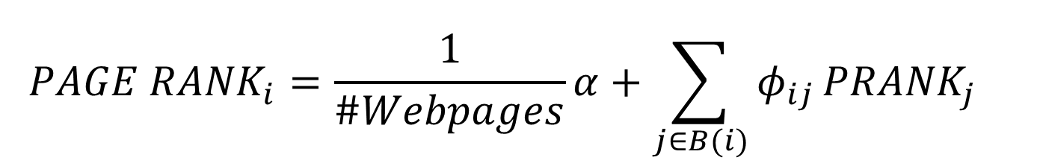
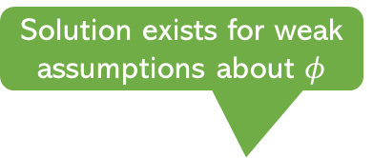
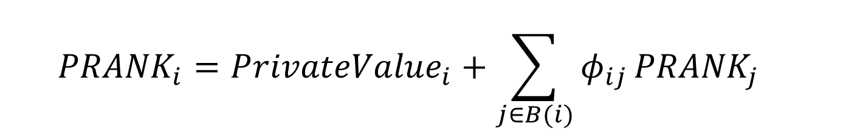

PRANK vs Page Rank
From random surfer to economic value
Social Value of Innovation
$${PRANK}_{i}=P{rivateValue}_{i}+{\sum_{j∈B(i)}{φ_{ij}}{PRANK}_{j}}_{}$$
Probability
All Innovations citing i
$${PAGE RANK}_{i}=\frac{1}{\#Webpages}α+{\sum_{j∈B(i)}{φ_{ij}}{PRANK}_{j}}_{}$$
Solution exists for weak assumptions about $φ$
$$φ_{Sij}=σ\frac{1}{{BC}_{j}}<1$$
A citation counts for less if innovation $i$ cites a lot

Slide 14

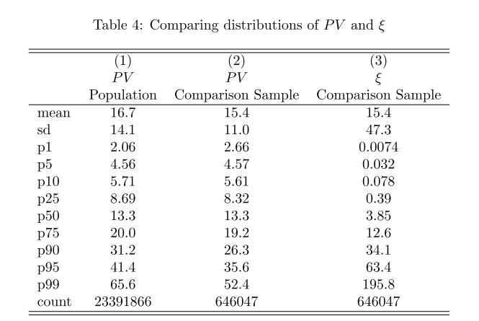

Private Value of an Innovation
Privat Value: Kogan (QJE2017) et al propose event study
$$ΔMarketValue_{Firm(i)}=\left(1−π_{j}\right)×PatentValue_{i}$$
Probability of Success
“Interpolation” to non-stock listed firms at level of 7,183 IPC classes and other inno characteristics
Notes:
We back out the private value from the stock market response a patent being granted.
This should be equal to 1-probability that patent is being granted – which is alredy priced in – times the actual private value…..
On average this suggest a private value of 15 million…

Slide 15
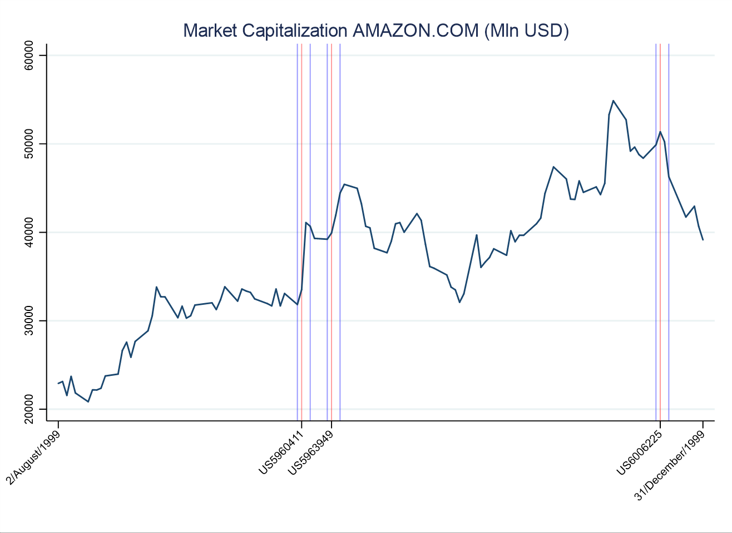
The private value of innovation Example: Amazon’s patents in 1999

Slide 16
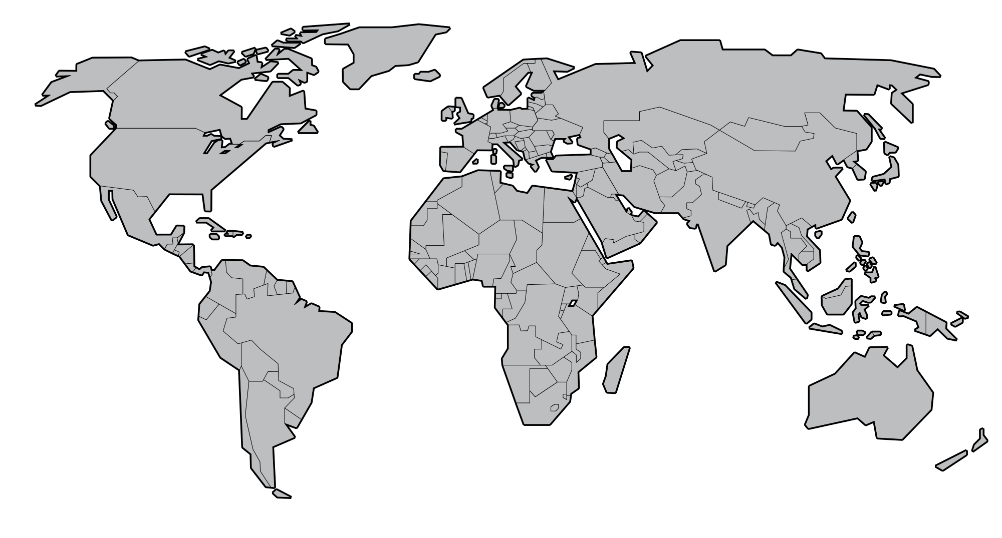
National vs Global Spillover

Slide 17

National vs Global
A
PV=$1MM
PV=$0.1MM
PV=$0.1MM
PV=$0.1MM

Slide 18





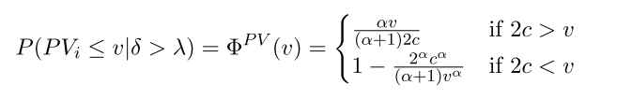
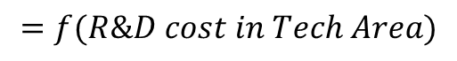
A simple model
$$=f(R\&D cost in Tech Area)$$
Flow of ideas (Pareto distribution)
Curvature of idea distribution
Project cost
Notes:
If R&D investmet per project is higher in a sector we expect to see a higher cut-off
If the Curve is steeper government subsidies will have a bigger effect = more high value projects just below the private sector cut-off

Slide 19
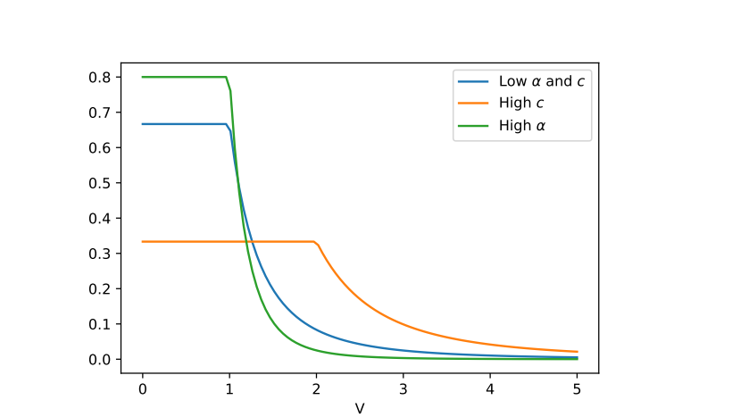
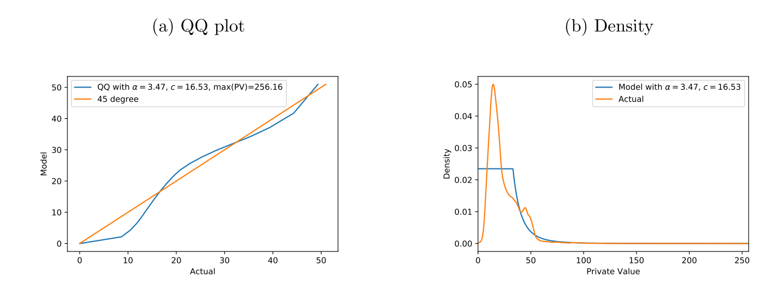
Inferring R&D spending from the private value distribution
Backing out the innovation response from the curvature of the private value distribution
Private Value
Backing out the R&D cost from the location of the peak of the private value distribution
Notes:
If R&D investmet per project is higher in a sector we expect to see a higher cut-off
If the Curve is steeper government subsidies will have a bigger effect = more high value projects just below the private sector cut-off

Slide 20

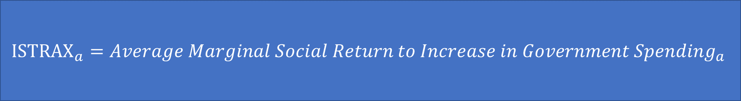
Indicators for Vertical Targeting
$$\frac{Average Spillover_{a}}{Average R\&D_{a}}$$
Technology Area a
Close to current approach by e.g. UK civil service
$${ISTRAX}_{a}=Average Marginal Social Return to Increase in Government Spending_{a}$$
Looks at both, profits of recipients and spillovers
Assumes that governments can only induce additional innovation by enticing firms to develop ideas that are of somewhat lower quality
Takes into account that the drop-off in quality varies between areas a
Notes:
If R&D investmet per project is higher in a sector we expect to see a higher cut-off
If the Curve is steeper government subsidies will have a bigger effect = more high value projects just below the private sector cut-off

Slide 21
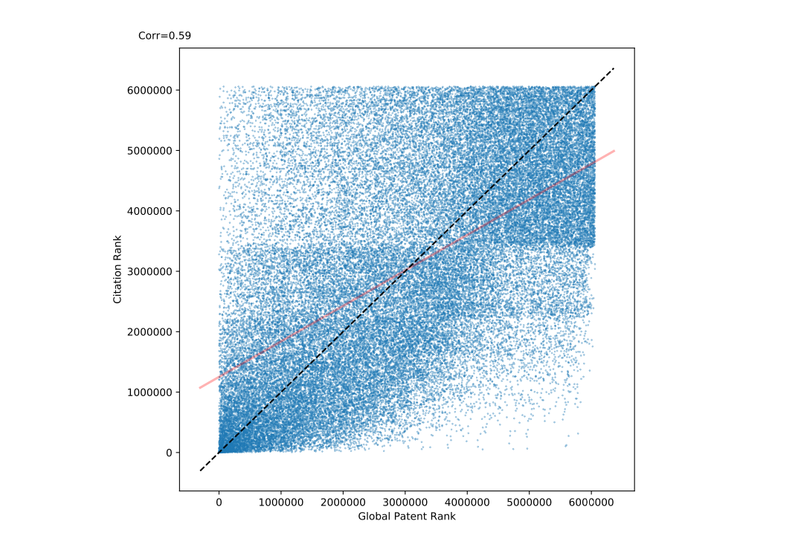
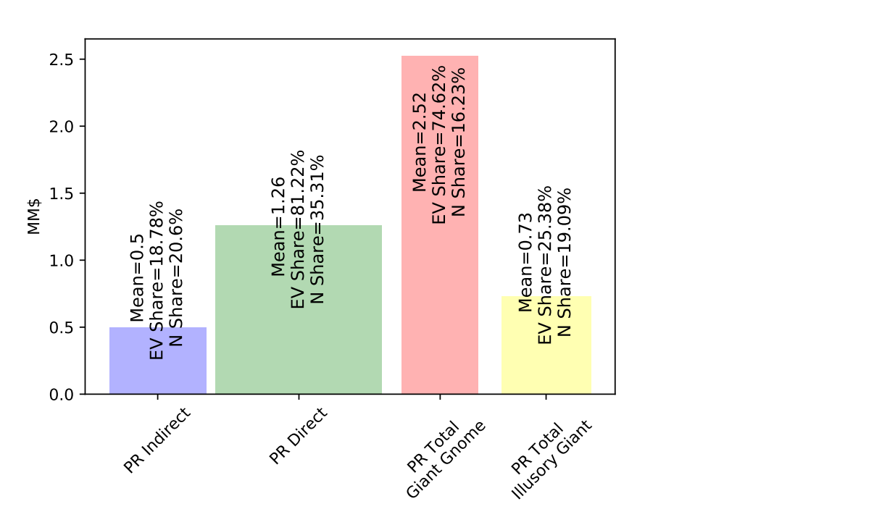
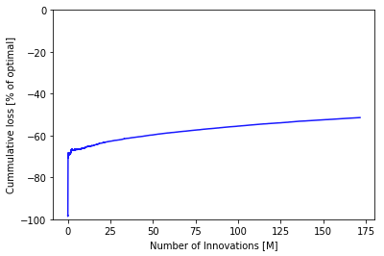
Some stylized PRANK facts: How important are Giant Gnomes?
Giant Gnomes are responsible for 70% of spillovers
Illusory Giants
Ordering innovations by citations means we miss more than 50% of external value
First order citations undervalue the socially most valuable innovations
Giant Gnomes
Notes:
How relevant are Giant Gnomes?

Slide 22
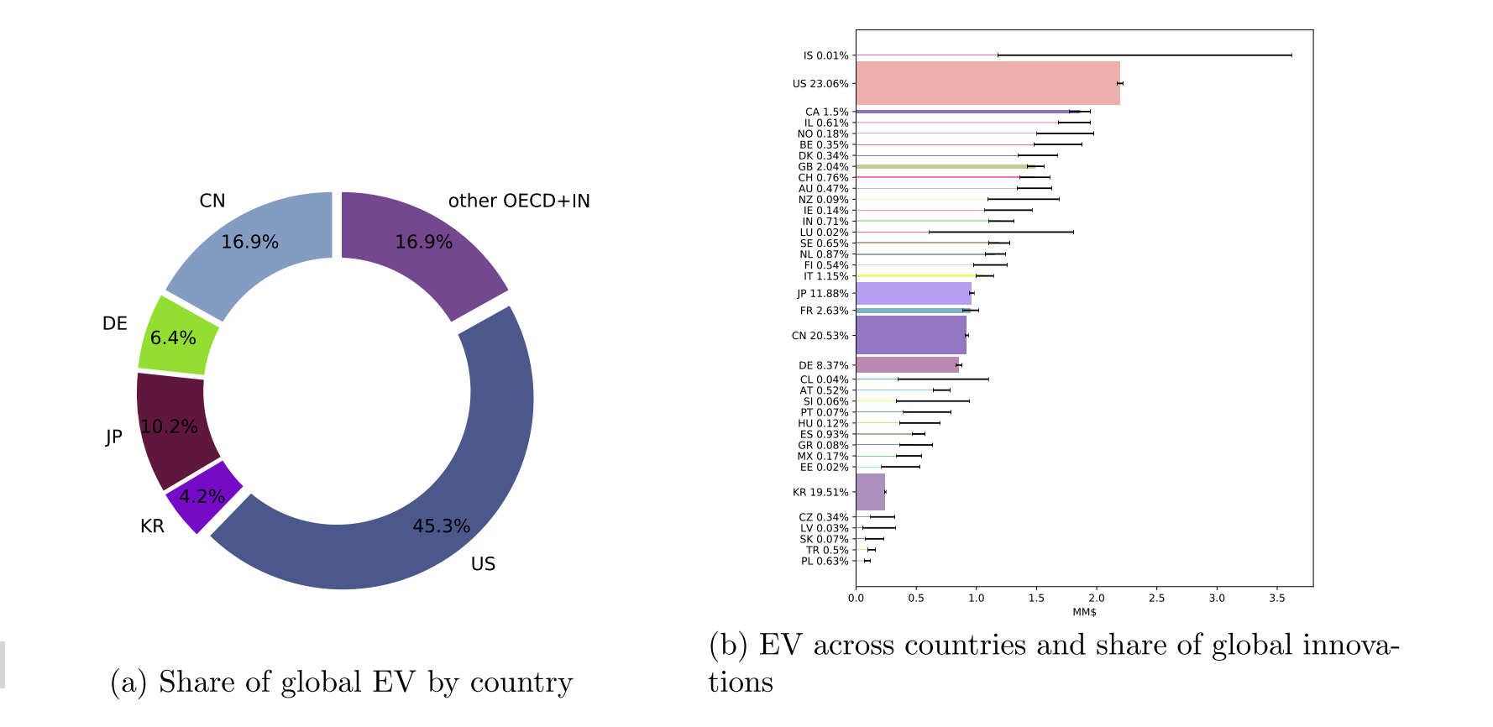
The origin of Global Spillovers
Per innovation spillovers in the UK are fairly high (~$1.5MM). But there are not so many innovations in the UK
EV=External Value = PRANK-PV

Slide 23
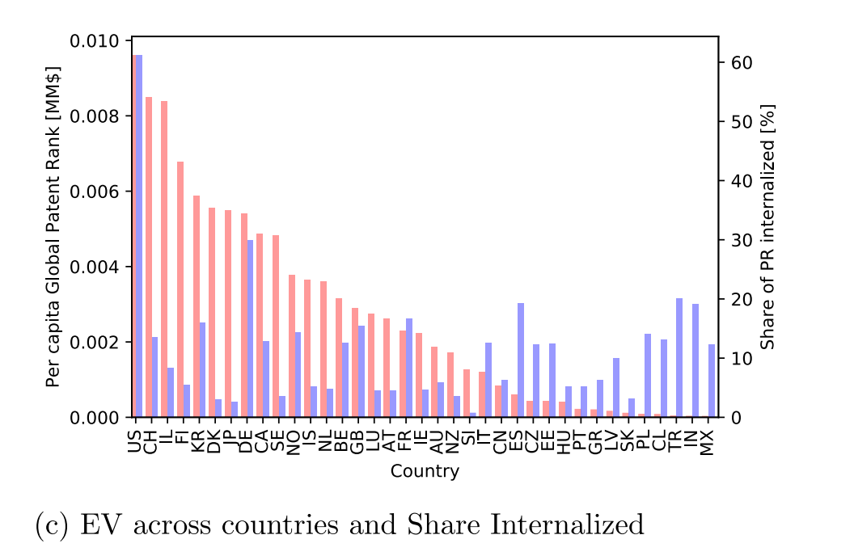
Internalization of spillovers?
Most (60%) US spillovers are internalised within the US
Germany is second best in internalizing spillovers (30%)
Only about 15% of UK spillovers are retained
While China has a big impact it’s mainly due to its size
Per capita the UK generates $2000 worth of spillovers (2004-2014)

Slide 24
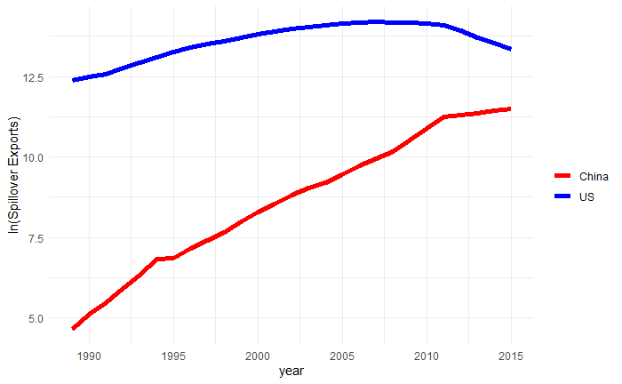
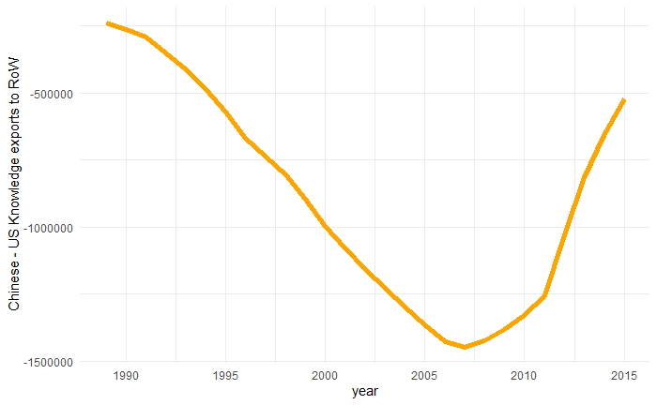
The balance of knowledge
US knowledge exports are declining since 2007
Chinese knowledge exports growing

Slide 25

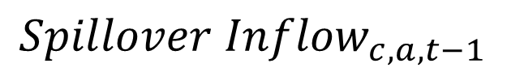

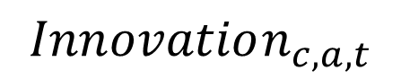
Can P-Rank Foresee the Future?
$$Innovation_{c,a,t}$$
2005-2014
Technology, country cells
$$Innovation_{c,a,t−1}$$
$${Spillover Inflow}_{c,a,t−1}$$
1995-2004
Yep: PRANK↑ 10% ⇒ Innos ↑ 1.8%

Slide 26
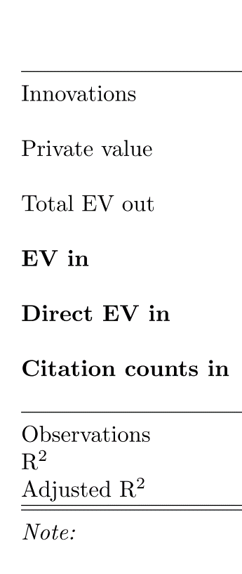
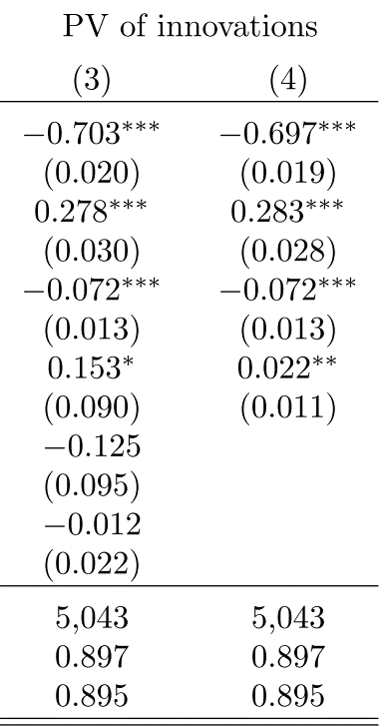

Can P-Rank Foresee the Future?
Dependent Variable
$$\frac{Private Value}{Past Innovations}$$
Yep: PRANK↑ 10% ⇒ Innos ↑ 0.22%
What matters are indirect spillovers
Not simple citation count
Not direct spillovers
Compare with Acemoglu et al 2016

Slide 27
What about vertical targeting? - Categories
COVID Core
'bio/pharma’,
'devices - ventilators',
'devices - respirators and surgical masks’
COVID Supporting
Remote productivity
Clean
Non fossil fuel based (solar, electric, wind)
Grey
Improving efficiency of fossil fuel techs
Dirty
Non Grey fossil fuel techs
Various other “trending” technologies
Inferred from patent classification system (including Y02)

Slide 28
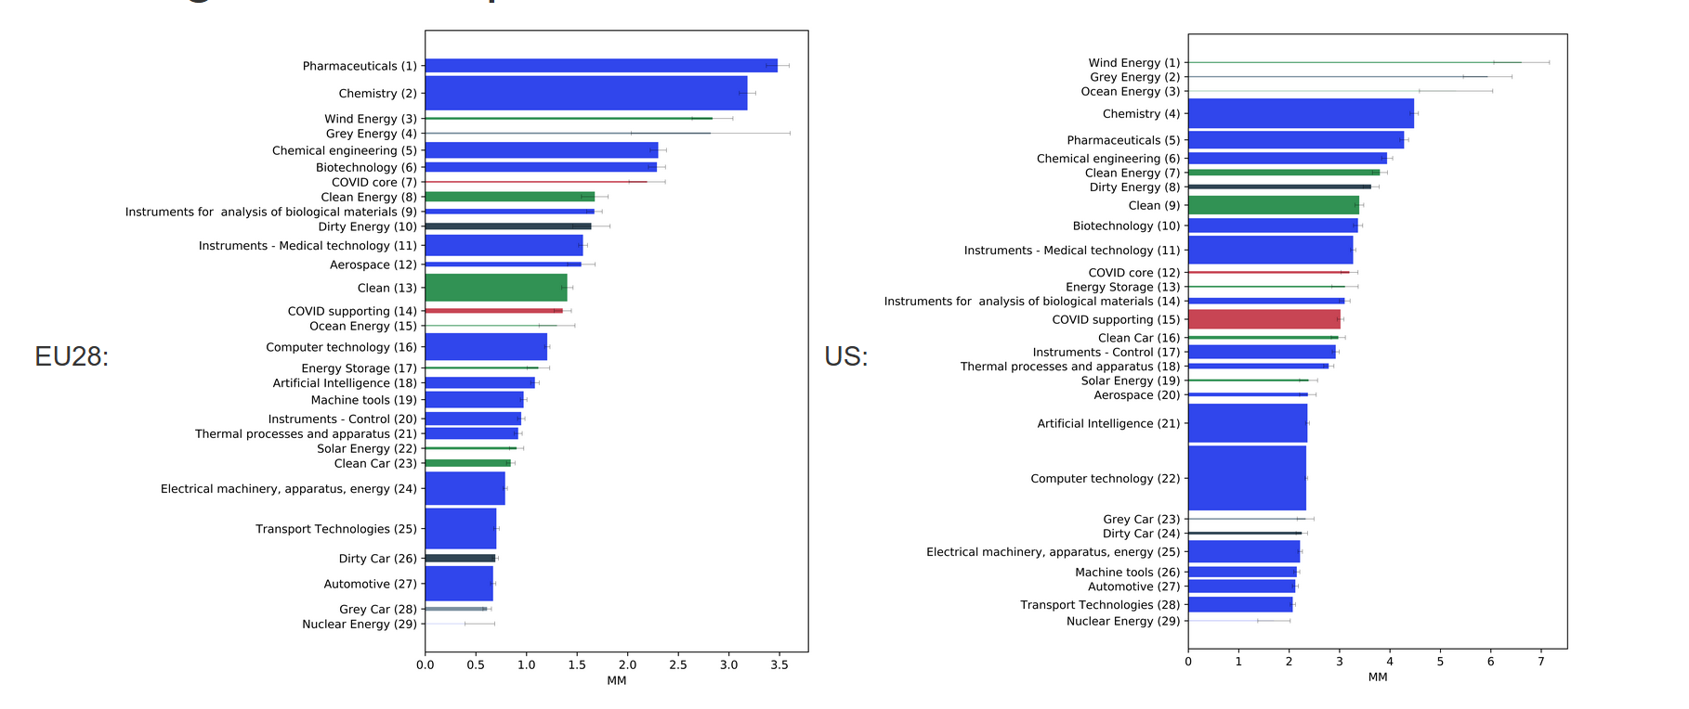
Global Average Spillovers
Significant and huge differences in average spillovers between techs and regions

Slide 29
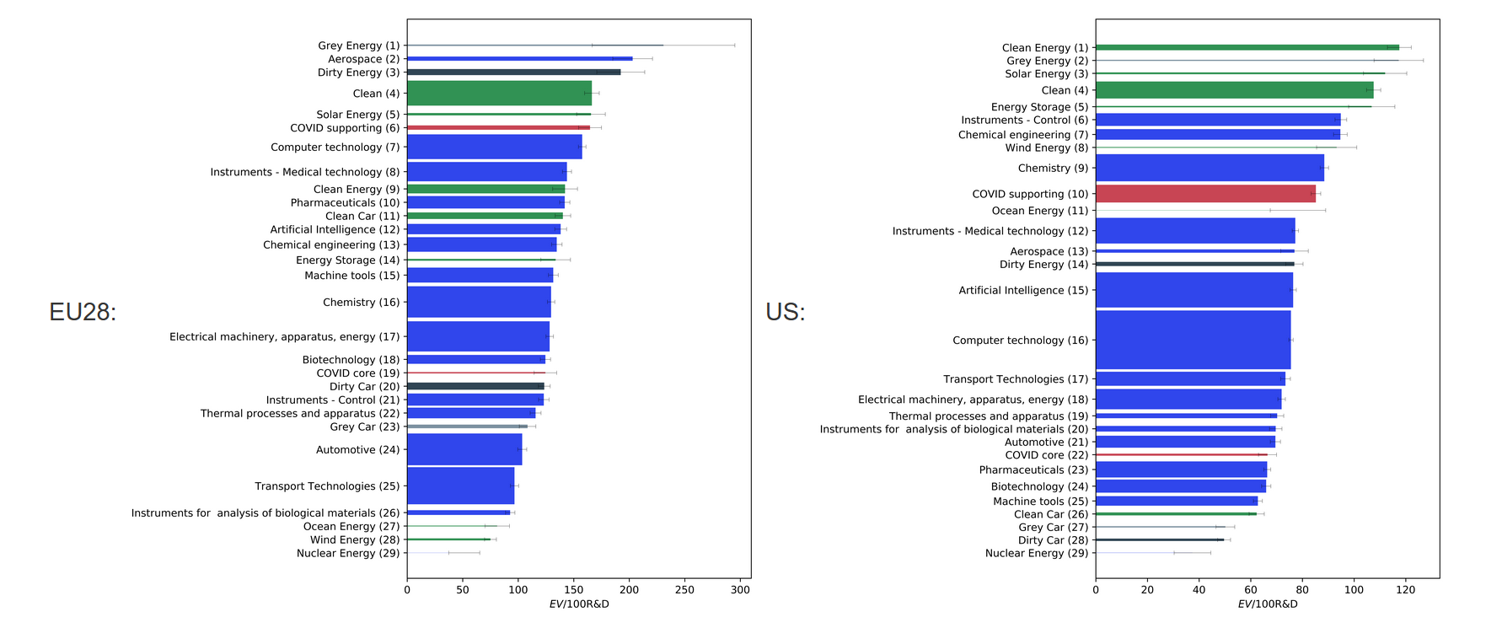
Global Spillover return per $ of R&D
Sometimes dirty techs are still near top
Also significant differences in returns
Some (not all) clean techs at the top end

Slide 30
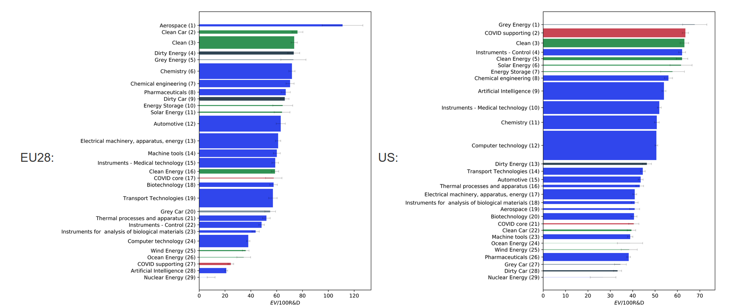
National Spillover return per $ of R&D
Clean Cars move up, clean energy down
National Policy makers still have incentive to support some clean techs, but the ranking of different clean techs might change

Slide 31
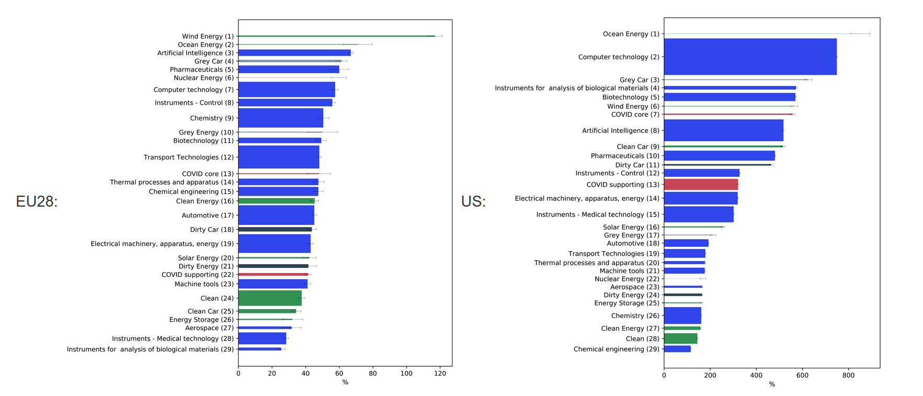
ISTRAX: National Return of increased support
Taking into account additionality bring ocean and wind to the top again

Slide 32

Summary & Conclusion
Significant and substantial variations in spillovers between different technology areas
Technology ranking varies between countries
Ranking changes depending on a global or regional/national perspective
Ranking changes again in terms of the responsiveness to R&D subsidies
Irrespective of the measure some clean technologies are typically ranked high
COVID related technologies have somewhat mixed record when it comes to social returns
Provides some basis for vertical targeting
Not necessarily the same ones
Scope for a clean recovery but needs to be carefully tailored to specific technologies and countries

Slide 33

Road ahead
Refinement of private value calculations
More Validation
Exploring variations of the methodology
Tailoring to needs of policy makers
Endogenizing categories? Unsupervised Topic Modelling?
Using framework for other applications
Assessment of mergers
Returns to R&D

Slide 34

Thanks
r.martin@imperial.ac.uk

Slide 35
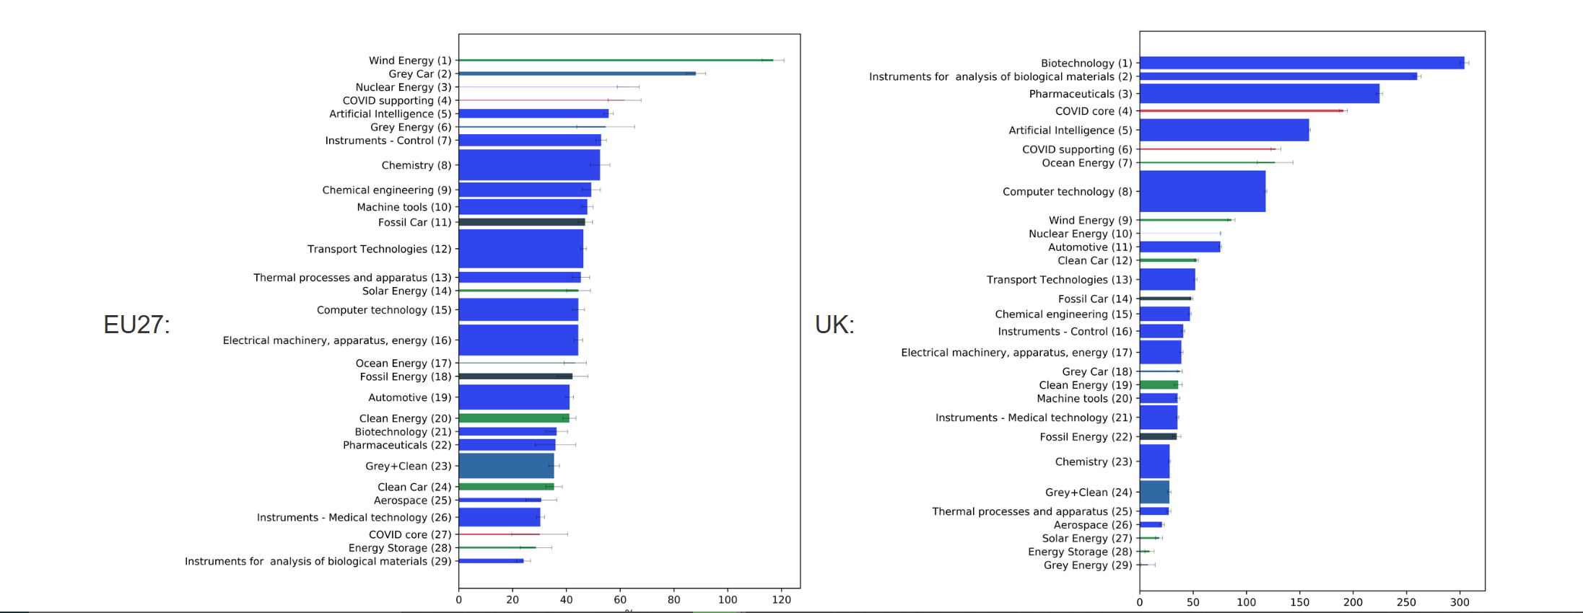
ISTRAX: National Return of increased support – EU 27 vs UK

Slide 36
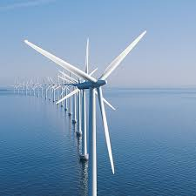

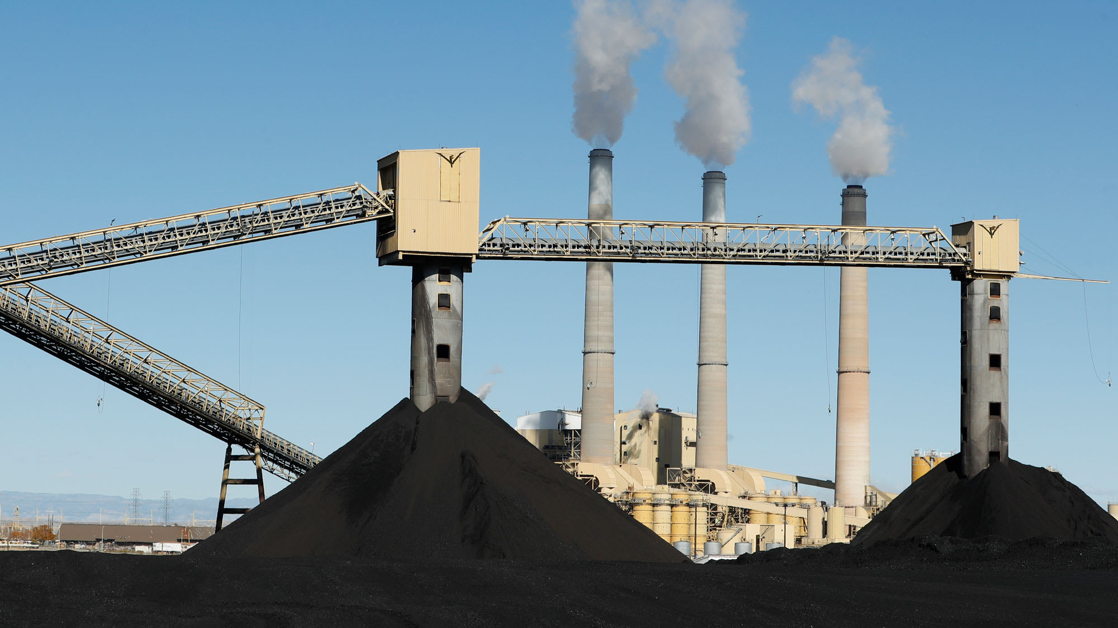
The impact of COVID on the clean transition
Are spillovers to clean larger?
R&D funds will shift to COVID
All else equal: is this better for clean or dirty?

Slide 37
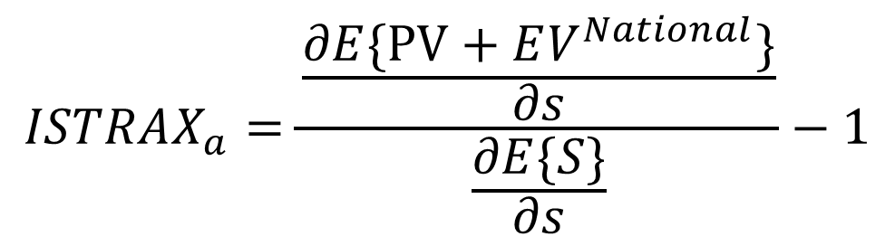

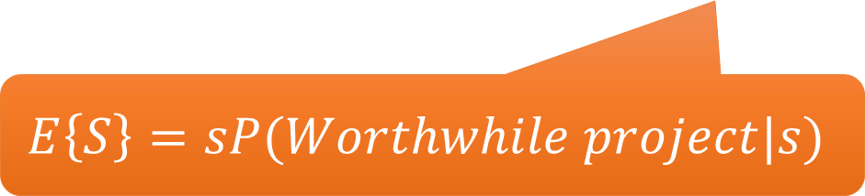
ISTRAX
s↑:
More projects
But: marginal project (slightly) lower quality
Expected spending by government.
$$ISTRAX_{a}=\frac{\frac{∂E\{PV+EV^{National}\}}{∂s}}{\frac{∂E\{S\}}{∂s}}−1$$
$$E\left\{S\right\}=sP(Worthwhile project|s)$$
Size of grants given out
${ISTRAX}_{a}=\frac{ΔSocial}{ΔPublic Spending}−1$
Notes:
If R&D investmet per project is higher in a sector we expect to see a higher cut-off
If the Curve is steeper government subsidies will have a bigger effect = more high value projects just below the private sector cut-off

Slide 38
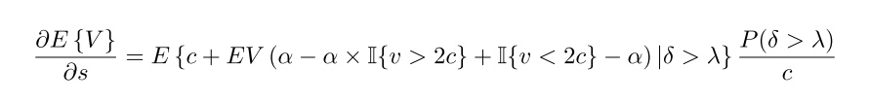
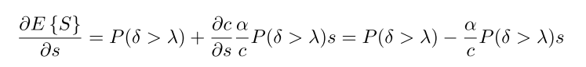
ISTRAX – Further detail
s↑:
More projects
But: marginal project (slightly) lower quality
Expected spending by government.
$$ISTRAX_{a}=\frac{\frac{∂E\{PV+EV^{National}\}}{∂s}}{\frac{∂E\{S\}}{∂s}}−1$$
$$E\left\{S\right\}=sP(Worthwhile project|s)$$
Size of grants given out
Notes:
If R&D investmet per project is higher in a sector we expect to see a higher cut-off
If the Curve is steeper government subsidies will have a bigger effect = more high value projects just below the private sector cut-off

Slide 39
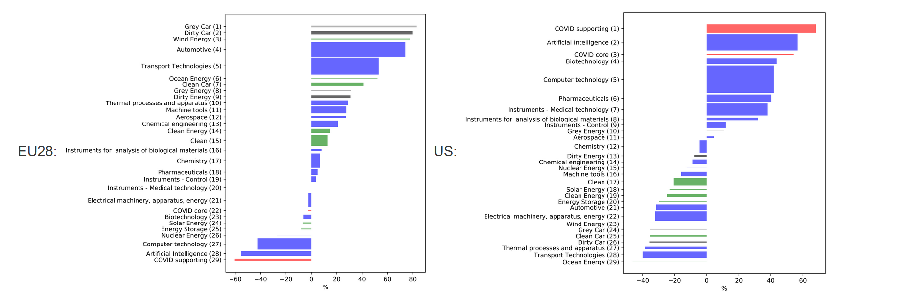
Comparative advantage (2005-14)
Share of tech category in region relative to OECD share
Notes:
EU has comparative advantage in Clean techs
US in covid techs

Slide 40
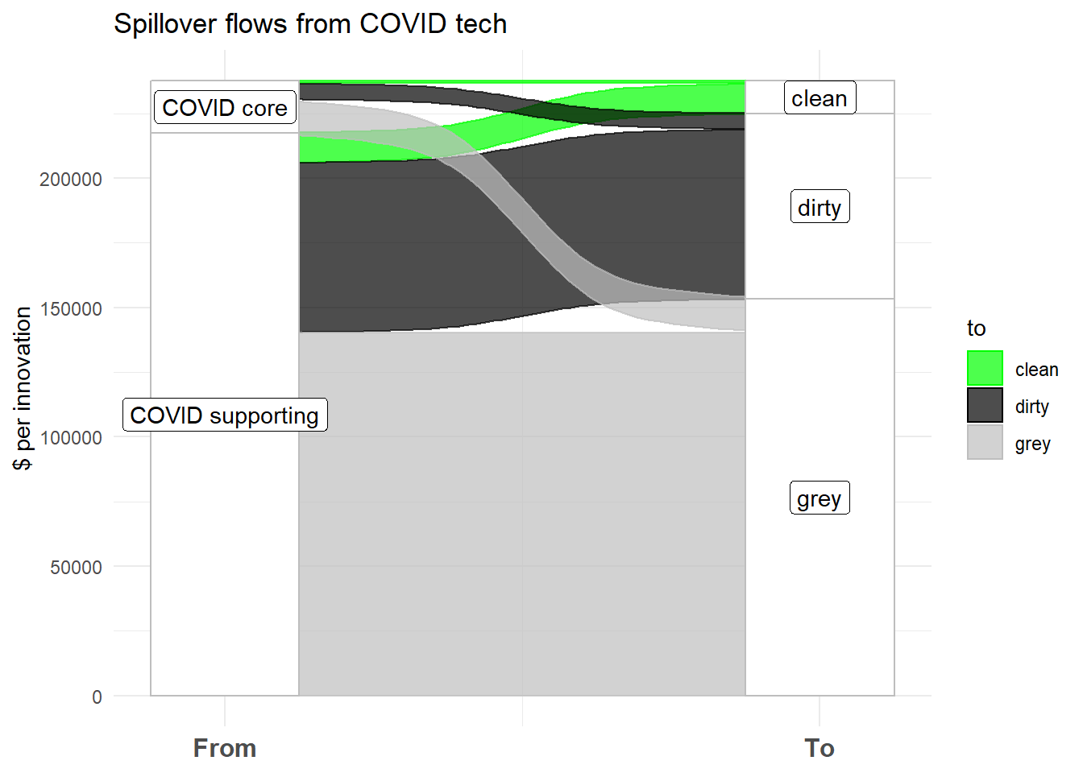
Spillover benefits of COVID research
There is less of a spillover flow from covid techs to clean (per clean innovation)
Every dirty innovation received on average $7K worth of spillovers from covid supporting techs

Slide 41
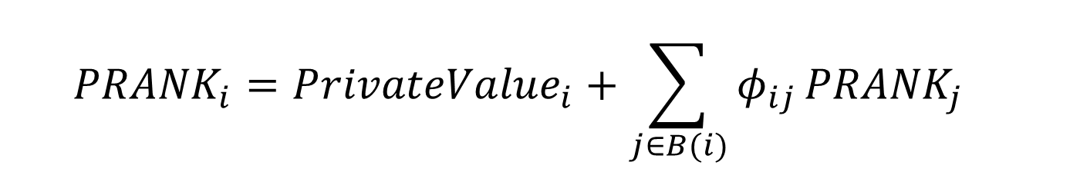
From PRANK to spillovers
$${PRANK}_{i}=P{rivateValue}_{i}+{\sum_{j∈B(i)}{φ_{ij}}{PRANK}_{j}}_{}$$
Social Value of an Innovation
$$Spillovers_{i}=PRANK_{i} −PrivateValue_{i}$$
External Value
Notes:
We give you fraction of the social value of all innovations that cite you.

Slide 42
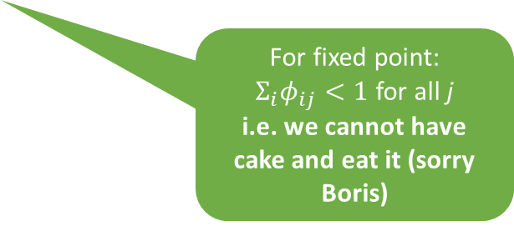
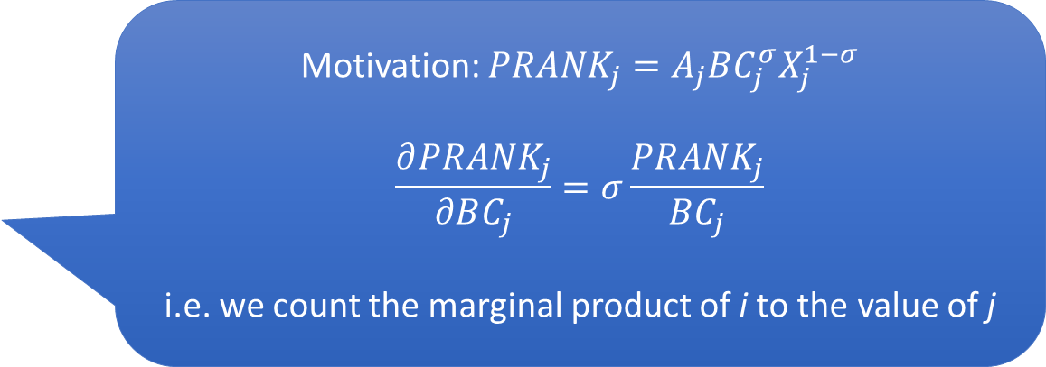
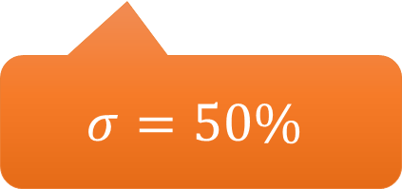
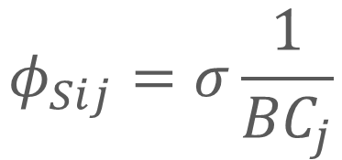
PRANK details
$${PRANK}_{i}=P{rivateValue}_{i}+{\sum_{j∈B(i)}{φ_{ij}}{PRANK}_{j}}_{}$$
For fixed point:
$Σ_{i}φ_{ij}<1$ for all j
i.e. we cannot have cake and eat it (sorry Boris)
Social value due to innovation i
Motivation: ${PRANK}_{j}=A_{j}BC_{j}^{σ}X_{j}^{1−σ}$
$$\frac{∂{PRANK}_{j}}{∂BC_{j}}=σ\frac{{PRANK}_{j}}{BC_{j}}$$
i.e. we count the marginal product of i to the value of j
$$φ_{Sij}=σ\frac{1}{{BC}_{j}}$$
Backward citations of innovation j
$$σ=50\%$$
Notes:
We give you fraction of the social value of all innovations that cite you.

Slide 43

The P-Rank of individual Innovations

Slide 44



Industrial Strategy and Regional Policy
Relative Productivity (2014)
Distribution of Innovation (2005-14)
Industrial Strategy guided by Innovation excellence could worsen regional productivity differences

Slide 45



Industrial Strategy and Regional Policy – Global Returns
Global ISTRAX (2005-14)
Relative Productivity (2014)
Industrial Strategy guided by Global Social Returns is possibly even worse for UK inequality

Slide 46



Industrial Strategy and Regional Policy – National Returns
Relative Productivity (2014)
National ISTRAX (2005-14)
Industrial Strategy guided by National Social Returns is neutral with respect to inequality

